Slide 1
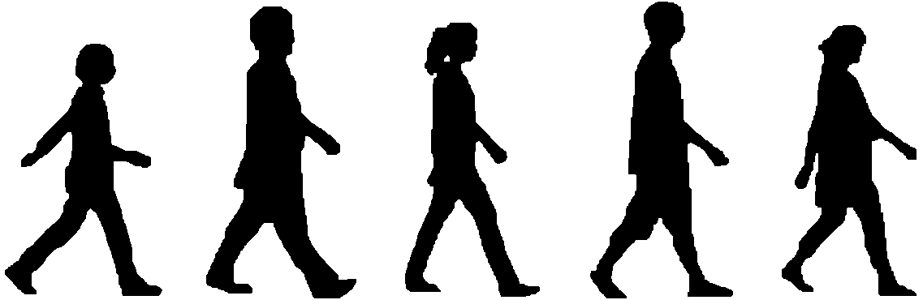
Gait-based person-verification system for forensics
Haruyuki Iwama, Daigo Muramatsu, Yasushi Makihara, Yasushi Yagi
Osaka University

Slide 2

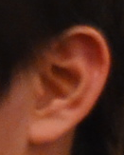

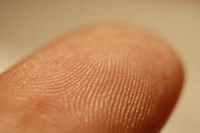

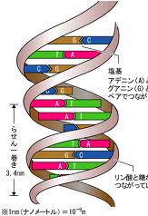
Gait for criminal investigation
Various biometric-based person verification techniques are used for criminal investigation
Biometrics
Face
Ear
Fingerprint
Gait
Handwriting
DNA

Slide 3


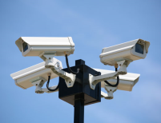
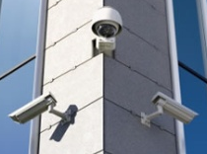
Gait for criminal investigation
Various biometric-based person verification techniques are used for criminal investigation
Gait feature:
Biometrics
Periodic averaging
Silhouette
Gait Energy Image
[Han and Bhanu 2006]
Face
Ear
Advantages:
Difficulty to disguise
Identification ability
from a distance
Fingerprint
Gait
Surveillance camera-based
perpetrator verification
Handwriting
DNA
Wide-view and low resolution

Slide 4
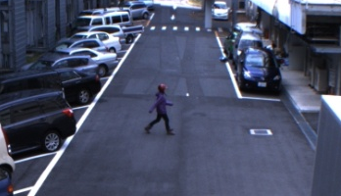



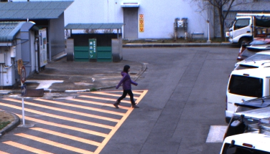




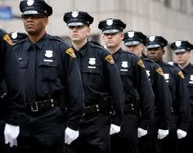
Workflow of gait-based criminal investigation
Perpetrator
Surveillance camera
Crime scene (Query)
Suspect
Reference scene
1. Footage acquisition
Criminal investigator
2. Request for verification
Gait specialist
4. Report of verification
Not having enough knowledge about gait
Researcher
Consulting service
(e.g., Prof. Yagi)
3. Analysis and verification
5. Decision to the next action for investigation
[Note] In the case of Yagi lab, Japan, there is at least one request for every month

Slide 5
Workflow of gait-based criminal investigation
Perpetrator
Surveillance camera
Crime scene (Query)
Suspect
Reference scene
1. Footage acquisition
Criminal investigator
2. Request for verification
Gait specialist
4. Report of verification
Not having enough knowledge about gait
Researcher
Consulting service
(e.g., Prof. Yagi)
3. Analysis and verification
5. Decision to the next action for investigation
Take extra time
Needs for speedy investigation

Slide 6
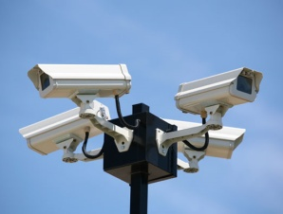
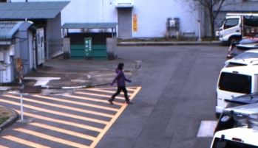

Gait-based verification system for forensics
Perpetrator
Surveillance camera
Crime scene (Query)
Suspect
Reference scene
1. Footage acquisition
Criminal investigator
Gait-based Verification System
Direct use
2. Analysis and verification
Not having enough knowledge about gait
for non-gait specialist
Contribution:
Construction of the first gait-based verification system for forensics
3. Decision to the next action for investigation

Slide 7
About constructed system
Verification framework
System design and operation

Slide 8


Verification framework
Verification SPEC in our system
Input : A pair of subjects
  Each subject walks straight with normally style in a sequence
  There is almost no view transitions in a sequence
  Views of the subjects are almost the same
Output : A posterior probability
  Two compared subjects are the same
Gait feature : Gait Energy Image (GEI) [Han and Bhanu 2006]
A posterior probability
Perpetrator
Verification
Engine
99.9 %
GEI-based analysis
Suspect

Slide 9
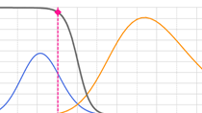
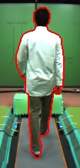
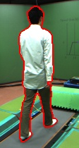
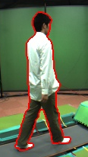
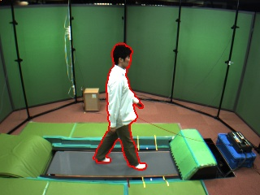
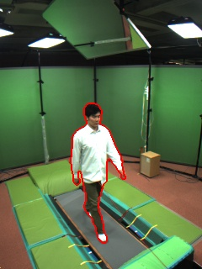
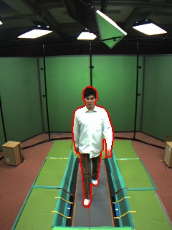
Verification framework
Circumstance-dependent probability
100%
Posterior probability
P(D|X,I)
P(X=1|D,I)
Same person
Random variable:
Different person
0%
Distance score between
two gait features
Circumstance-dependent probability density function (PDF) of distance scores
Circumstances with compared two gait features
Trained by Multi-view Gait DB [makihara et al. 2012]
Size (GEI size)
Frame rate
View
Feature mask
131 subjects, 25 views, 60 [fps]

Slide 10




Verification framework
How input circumstances are decided in our system?
Size (GEI size) : Automatically decided
  Decided by the smaller size of the two compared subjects
Frame rate : User input
  User should know the frame rate in advance
View : User input
  User selects the most similar view with
  the input from a set of discrete views
  of our multi-view database
Feature mask : User input
  User judges where to mask by visual
  and specifies the block-wise mask
Input
Database
…

Slide 11
About constructed system
Verification framework
System design and operation

Slide 12
Requirements on system operation
User confirmation in verification process
Easy-to-use interface
Full automatic system does not guarantee the perfect results
Interactive operation
Graphical user interface and mouse-based operation

Slide 13
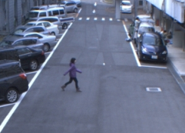



Data flow of constructed system
Query
Reference
Verification result
Posterior probability
99.9 %
Multi-view
Gait DB
Registration module
Verification module
Subject selection
(detection & tracking)
Feature (GEI) creation
Posterior calculation
Silhouette creation module
Subject segmentation

Slide 14
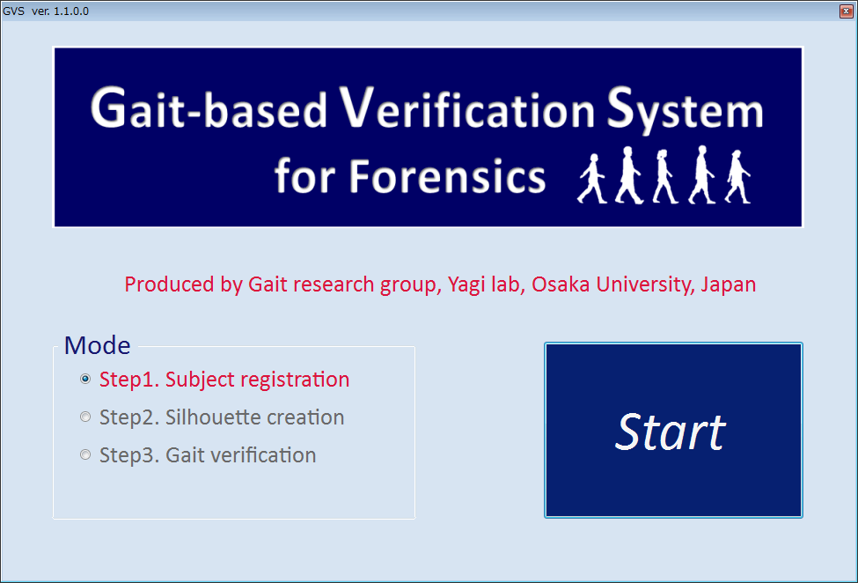
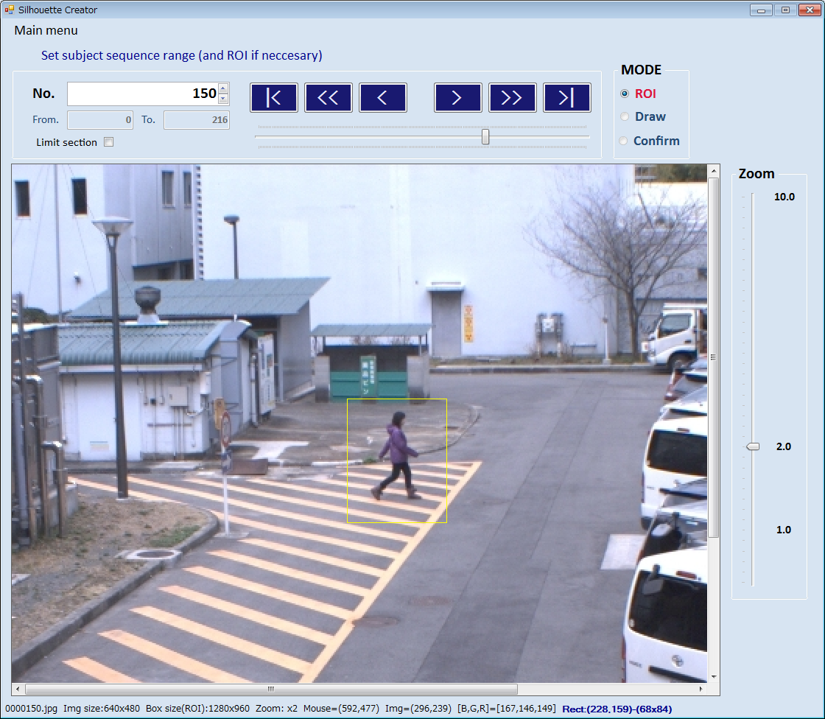
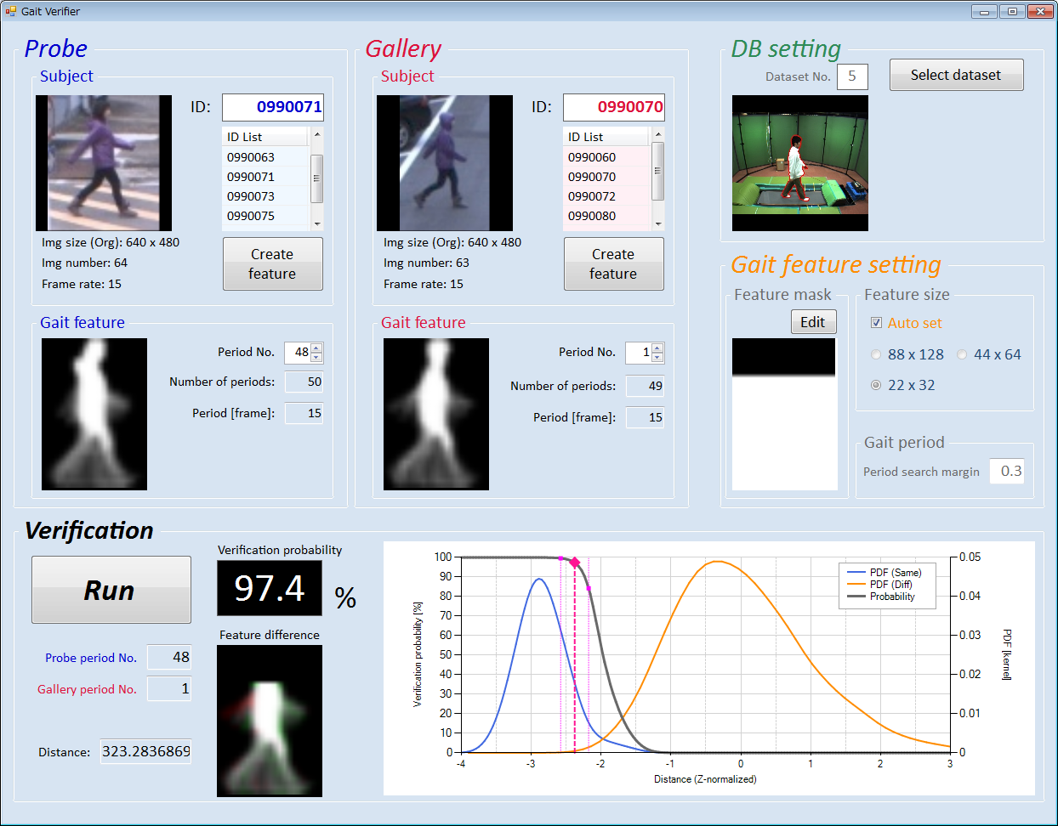
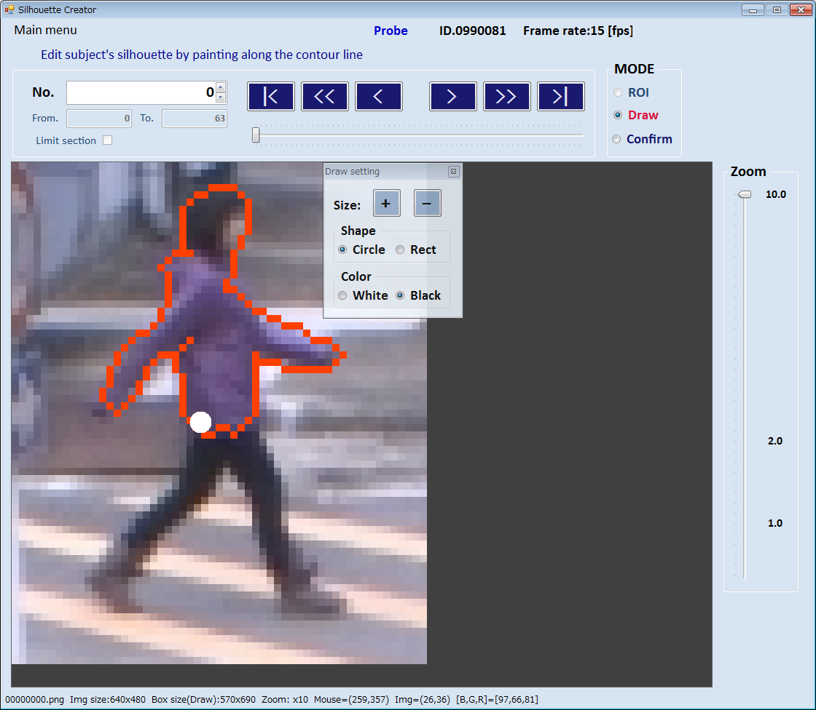
GUI of constructed system
Main menu dialog
1. Registration dialog
3. Verification dialog
2. Silhouette creation dialog

Slide 15
Implementation
The system is implemented on the mixed platform of C#, C++/CLI, and C++ using Visual Studio 2008 (Professional Edition) with .net framework 3.5 SP1.
OpenCV library (version 2.3) is used for image processing.
The system runs on computers operating Windows XP, Windows Vista, and Windows 7.

Slide 16
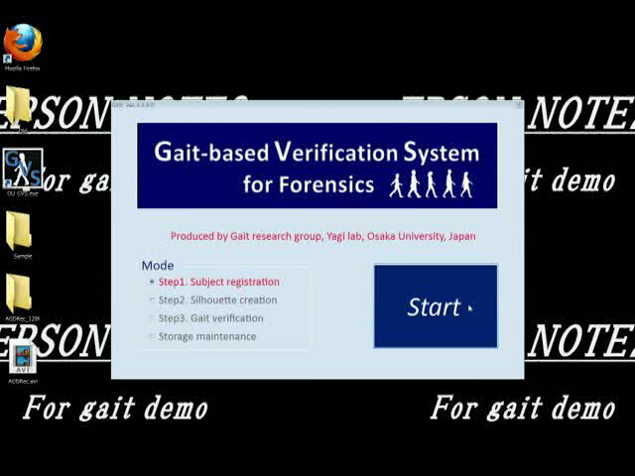
User operation : Step1. Registration

Slide 17
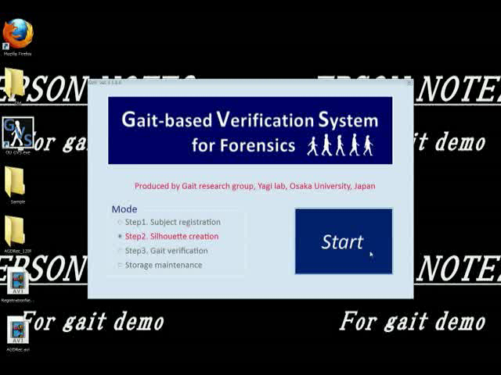
User operation : Step2. Silhouette creation 1

Slide 18
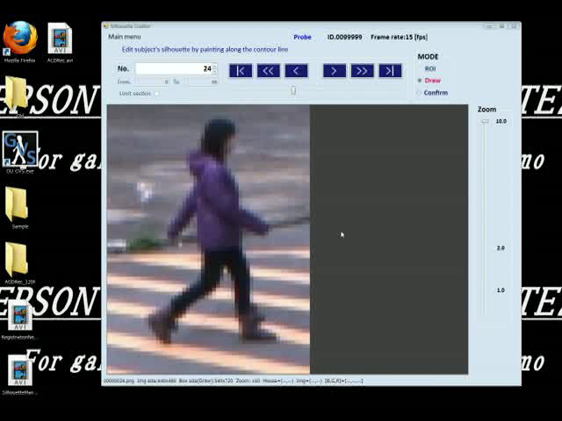
User operation : Step2. Silhouette creation 2

Slide 19
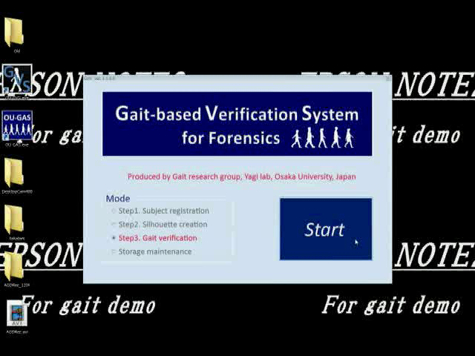
User operation : Step3. Verification

Slide 20
Experiments on system usability
Participant : 9 people
  Gait researcher : 1 (developer of this system)
  Non-gait researcher : 8
    Gender : 3 males and 5 females
    Age : approx. 20 to 50 years old
    Computer literacy : enough
Operation training
  Instruction : approx. 90 minutes
  Training : approx. 4 to 5 hours using preliminary data

Slide 21
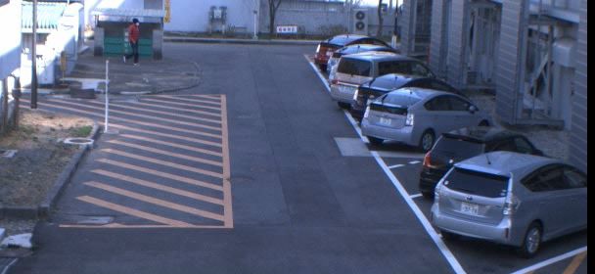

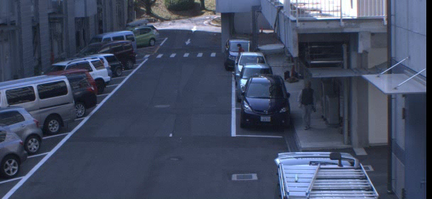

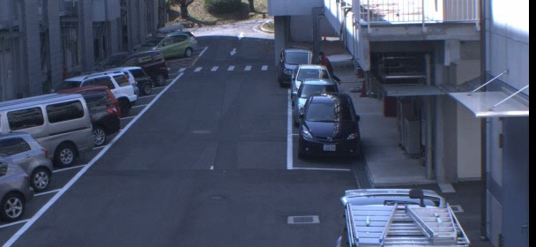

Experimental data set 1
Query Y
Reference A
Frame rate : 5 fps
Reference B
Subject height: approx. 50 to 100pix
Frame rate : 5 fps
Subject height: approx. 50 to 80 pix

Slide 22
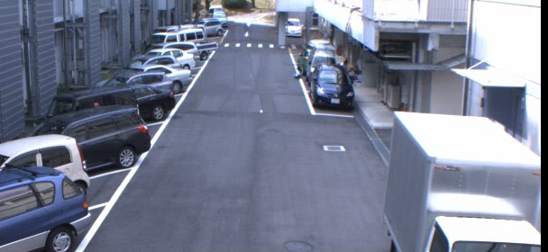

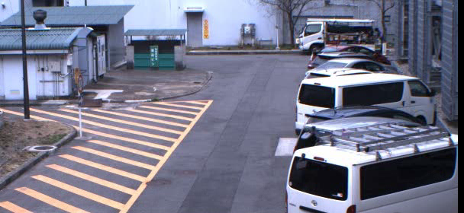
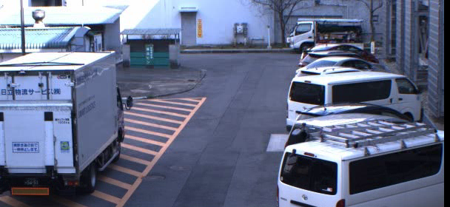

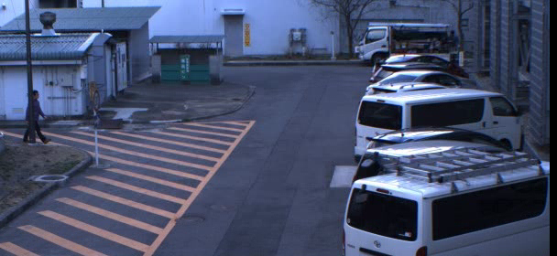

Experimental data set 2
Query Z
Reference C
Reference D
Frame rate : 15 fps
Subject height: approx. 60 pix
Reference E
Frame rate : 15 fps
Subject height: approx. 60 pix

Slide 23
Results : Verification result
Output posterior probability [%]
Query | Ref. | Participant ID
 |  | 1 | 2 | 3 | 4 | 5 | 6 | 7 | 8 | 9
Y | A | 1.0 | 2.0 | 0.8 | 0.1 | 1.5 | 2.7 | 0.5 | 0.0 | 0.2
 | B | 100.0 | 100.0 | 99.9 | 99.9 | 100.0 | 100.0 | 100.0 | 100.0 | 100.0
Z | C | 99.9 | 99.1 | 97.1 | 98.9 | 99.8 | 98.5 | 99.8 | 99.8 | 99.8
 | D | 9.5 | 15.9 | 14.8 | 6.3 | 13.9 | 23.0 | 20.4 | 34.2 | 0.7
 | E | 61.8 | 18.6 | 36.0 | 58.8 | 32.7 | 26.2 | 36.3 | 67.4 | 40.4
Gait researcher
Data set1
Data set 2
Query Y
Ref. A
Ref. B
Query Z
Ref. C
Ref. D
Ref. E

Slide 24
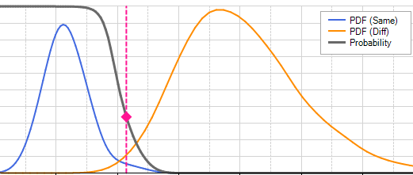
Results : Verification result
Output posterior probability [%]
Query | Ref. | Participant ID
 |  | 1 | 2 | 3 | 4 | 5 | 6 | 7 | 8 | 9
Y | A | 1.0 | 2.0 | 0.8 | 0.1 | 1.5 | 2.7 | 0.5 | 0.0 | 0.2
 | B | 100.0 | 100.0 | 99.9 | 99.9 | 100.0 | 100.0 | 100.0 | 100.0 | 100.0
Z | C | 99.9 | 99.1 | 97.1 | 98.9 | 99.8 | 98.5 | 99.8 | 99.8 | 99.8
 | D | 9.5 | 15.9 | 14.8 | 6.3 | 13.9 | 23.0 | 20.4 | 34.2 | 0.7
 | E | 61.8 | 18.6 | 36.0 | 58.8 | 32.7 | 26.2 | 36.3 | 67.4 | 40.4
Inter-user variation is relatively high
Inter-user variation in distance score is almost the same with other cases
The sensitivity of the posterior probability is high
Small distance difference causes large posterior difference
Posterior probability
Posterior probability curve
Distance score

Slide 25
Results : Operate time
Average time (Max time) [min]
Operation step | Participant ID
 | 1 | 2 | 3 | 4 | 5 | 6 | 7 | 8 | 9
Registration (for 1 subject) | 3 (4) | 3 (4) | 3 (4) | 3 (4) | 5 (5) | 4 (5) | 4 (4) | 4 (5) | 5 (7)
Silhouette creation (for 1 subject) | 19 (25) | 21 (26) | 14 (38) | 23 (30) | 28 (29) | 21 (29) | 22 (28) | 13 (15) | 26 (40)
Verification (for 1 pair) | 1 (1) | 1 (1) | 2 (2) | 1 (2) | 3 (3) | 2 (4) | 1 (2) | 1 (2) | 2 (3)
One total verification | 43 (52) | 46 (53) | 37 (45) | 50 (63) | 68 (73) | 53 (58) | 53 (82) | 34 (38) | 64 (83)
longest
All participants were able to use the system and obtain reasonable verification results in less than 90 [min]

Slide 26

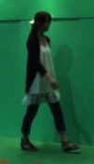
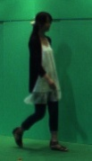
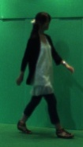




Limitation and Future work
The verification result is valid only for a pair of sequences with same views and with almost no view transitions
Only verification mode is implemented
Cannot apply
verification
View transformation model-based view-invariant verification framework [makihara et al. 2006]
Identification mode (1 to N matching)

Slide 27
Conclusion
The first (non-private) gait-based person verification system for criminal investigation is constructed
Experimental results show that non-gait specialist (non-gait researchers) can use the system appropriately and obtain reasonable verification results
Although there are some limitations, our system will contribute much to the criminal investigation by allowing the criminal investigator to analyze gait immediately by themselves

