Slide 1
The OU-ISIR Gait database Comprising the Large Population Dataset and Performance Evaluation of Gait Recognition

Slide 2
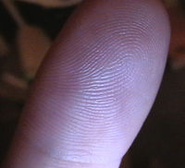



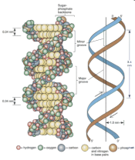
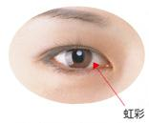
Introduction
Gait-based biometrics at a distance
Application to wide-area surveillance
High
DNA
Precision
Iris
Finger
print
Face
Gait
Low
Near
Far
Distance from a sensor
Gait database is essential for the development of gait-based biometrics

Slide 3
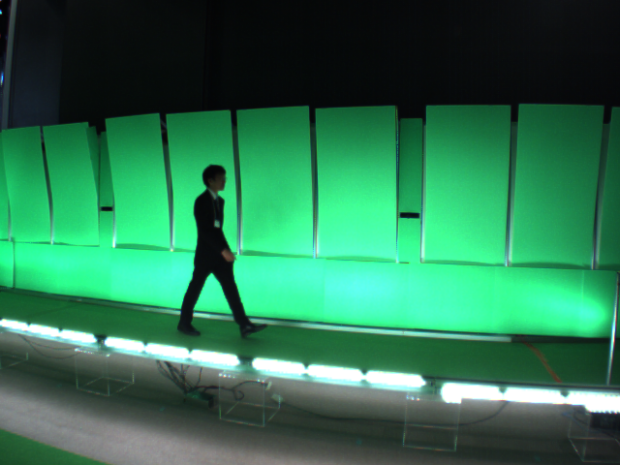
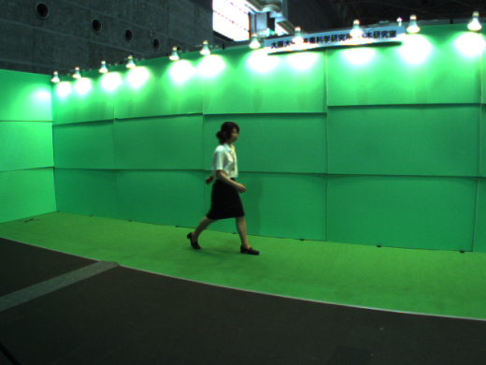
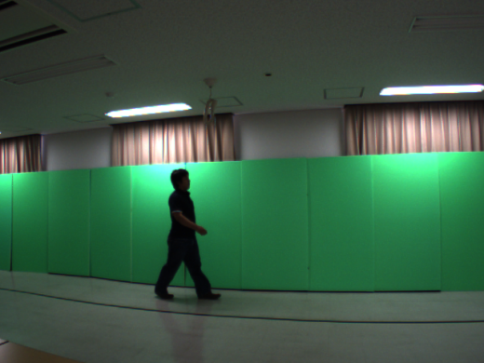
Related work
Existing major gait database
Evaluation of the robustness
Large
At most 185 subjects
Genders and ages are biased
Soton
Nixon et al. 2001
USF
Sarkar et al. 2005
Variation in walking conditions
CASIA
Yu et al. 2006
OU-ISIR Treadmill
Mori et al. 2010
Mannami et al. 2010
Camera pose variations introduce
bias into the evaluation results
Performance evaluation with statistical reliability
Large population
Okumura et al. 2010
Makihara et al. 2011
Small
Small
Large
Number and diversity of subjects
Number and diversity of subjects

Slide 4
Objective
Construction of the world’s largest gait database
Focus on “Number and diversity of subjects”
Investigation of the upper limit of gait-recognition performance in statistically reliable way
Study on the difference of gait-recognition performance between genders and age groups

Slide 5
Proposed dataset
“The OU-ISIR Gait Database, Large Population Dataset” (OU-LP)
Major upgrade of previous works
1,035 subjects in Okumura et al. 2010
1,728 subjects in Makihara et al. 2011
Extensions from the previous works
Number of subjects : 4,007
2,135 males and 1,872 females with age ranging 1 to 94 year old
All silhouette images are normalized
Biases of camera rotation are removed
Observation angles of subjects are specifically defined
Previous work merely defined as “side view”
Statistically reliable evaluation
More equitable evaluation
Fair analysis in terms of the observation angles

Slide 6
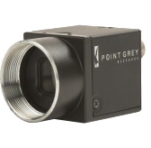
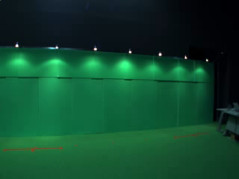
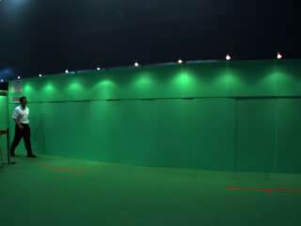
Capturing system
Acceleration section
Capture interval
Deceleration section
Start
3 m (approx.)
4 m
3 m (approx.)
End
Walking course
Point Grey research Flea2
Image size
VGA (640 by 480 pixel)
Frame-rate
30 fps
Green carpet
Green panel
4 m (approx.)
Camera 2
Camera 1
Camera 1

Slide 7
Data collection
In conjunction with demonstration in five exhibitions
Each subject
Signed release agreement for research-purpose use
Provided gender and age information
Exhibition | Term | #Days | #Visitors (approx.)
Outreach activity in DIM (Dive Into the Movie) project | March 2009 | 3 | 1,600
5th Regional Disaster and Crime Prevention Expo | June 2010 | 2 | 280
Open campus at Osaka university 2010 | Aug 2010 | 1 | 70
Open campus at Osaka university 2011 | Aug 2011 | 1 | 90
Outreach activity in CREST project | Aug 2011 | 5 | 2,000

Slide 8
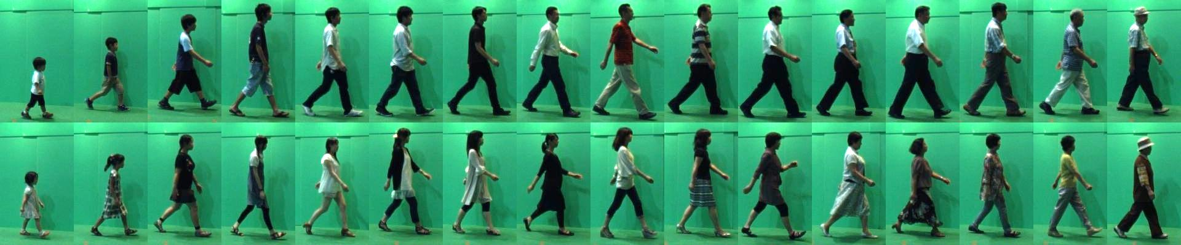
Statistics of OU-LP
Number of subjects : 4,007 (2,135 males and 1,872 females)
Distributions of subject’s gender and age
Examples

Slide 9
Subsets of OU-LP
Two primal subsets
2 sequences/subject : OU-LP-A
1 sequence/subject : OU-LP-B
Evaluation of recognition performance
Investigation of gender/age estimation

Slide 10
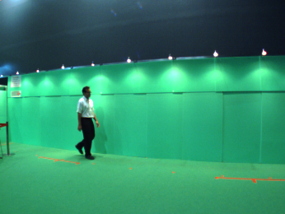
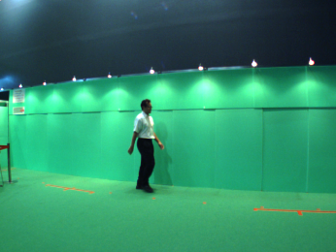
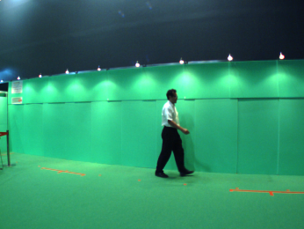
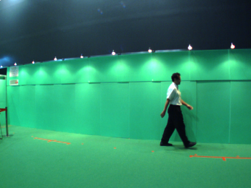
Subsets of OU-LP
Two primal subsets
2 sequences/subject : OU-LP-A
1 sequence/subject : OU-LP-B
Further subsets based on observation angle
Evaluation of recognition performance
Investigation of gender/age estimation
Z
Y
Surface of wall (green panel)
Walking direction
X
A section of 85 [deg]-centered gait period
: Subject
A section of 75 [deg]-centered gait period
: Observation angle
A section of 65 [deg]-centered gait period
: Line of sight
A section of 55 [deg]-centered gait period
Camera center

Slide 11
Subsets of OU-LP
Two primal subsets
2 sequences/subject : OU-LP-A
1 sequence/subject : OU-LP-B
Further subsets based on observation angle
Number of subjects
Evaluation of recognition performance
Investigation of gender/age estimation
Primal subset | Observation angle |  |  |  |  | Total
 | 55 [deg] | 65 [deg] | 75 [deg] | 85 [deg] | All
A | 3,706 | 3,770 | 3,751 | 3,249 | 3,141 | 3,835
B | 3,998 | 4,005 | 4,002 | 3,923 | 3,904 | 4,007
A/B-55
A/B-65
A/B-75
A/B-85
A/B-All

Slide 12
Advantages
Large population
4,007 subjects in total
Approx. 20 times more than the existing public gait database
Whole generation
Age range from 1 to 94 yrs
Each 10-year intervals contains over 400 subjects (from 5 to 49 yrs)
Gender balance
Male : Female = 1.1 : 1
Silhouette quality
All the silhouette images are visually checked at least twice and manually modified if necessary

Slide 13
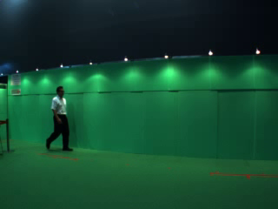

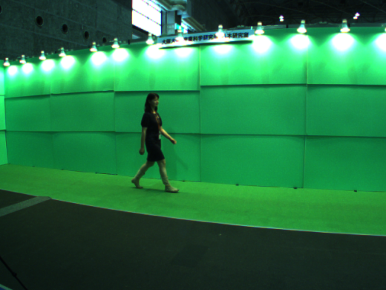
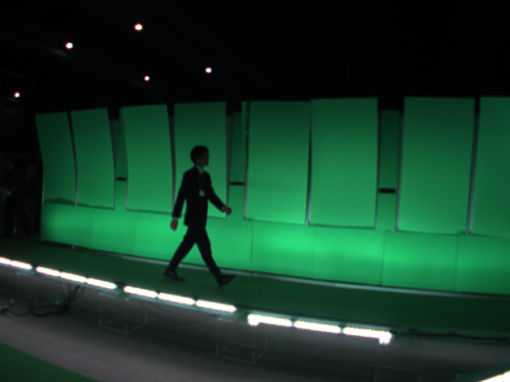
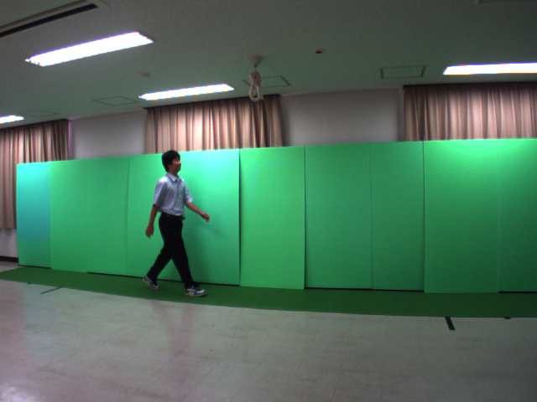
Preprocessing Silhouette extraction
Direct use introduces some biases in evaluation results
Background subtraction
Manual denoising if necessary
Original sequence
Silhouette sequence
Camera-pose variation

Slide 14
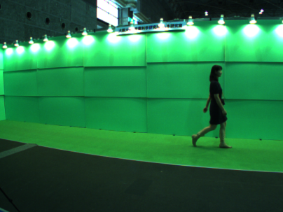
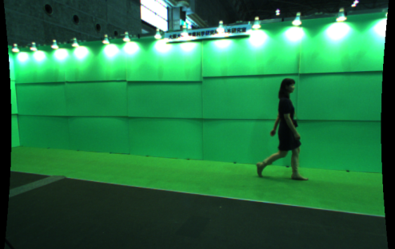
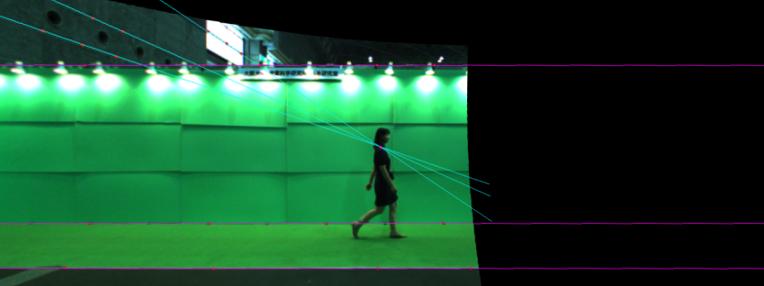
Preprocessing Correction of camera rotation
Z
Y
Original captured image
Subject
X
z
Image plane
Camera coordinate system
x
y
Distortion corrected image
Rotation correction by using vanishing points
Z
Y
[Tsuji et al. 1985]
Vertical center of image
Subject
X
z
Camera coordinate system
Image plane
x
Rotation corrected image
y

Slide 15
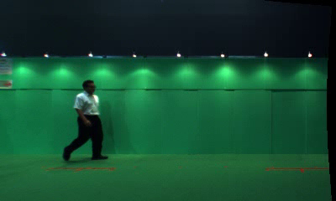












Preprocessing Creation of size-normalized silhouette
Background subtraction
Original sequence
Silhouette sequence
Rotation correction
Registration and size-normalization
88 x 128 pixel
Size-normalized silhouette sequence

Slide 16
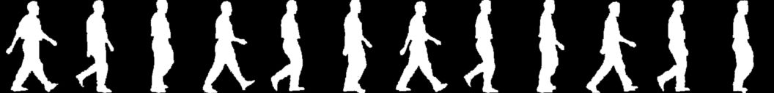


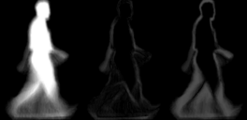




Gait recognition approach
Gait period detection
Gait feature matching
Probe
Gallery
Direct matching
P
Period detection
t
Dissimilarity is measured by L2 norm
Gait feature creation : appearance and period-based features
Gait Energy Image (GEI)
Frequency Domain Feature (FDF)
Gait Flow Image (GFI)
Chrono-Gait Image (CGI)
Gait Entropy Image (GEnI)
Masked GEI (MGEI)
Han and Bhanu 2006
Makihara et al. 2006
Lam et al. 2011
Wang et al. 2010
Bashir et al. 2009
Bashir et al. 2010

Slide 17
Experiments
Performance evaluation of gait recognition
1. Effect of number of subjects
2. Comparison of gait feature
3. Effects of gender and age

Slide 18
Performance evaluation of gait recognition Effect of number of subjects
Data set: OP-LP-A-65 (3,770 subjects)
Reliability comparison: Whole set vs. Subset (100 subjects)
Gait feature: GEI
ROC curve
Gray bar: observed deviation in 100 different subsets
Estimated standard deviation
: observed FRR
: #subjects
[Snedecor and Cochran 1967]

Slide 19
Performance evaluation of gait recognition Gait feature comparison
GEnI
MGEI
GEI
FDF
CGI
GFI
Data set: OP-LP-A-All (3,141 subjects)
ROC curve
CMC curve
Better performance
Better performance
Performance order
GEI ≈ FDF > CGI ≈ GEnI > GFI > MGEI
※ Performance older was almost
independent of the observation angle

Slide 20
Performance evaluation of gait recognition Effects of gender and age
Data set: OP-LP-A-65 (3,770 subjects)
Gait feature: GEI
Performance comparison between gender/age groups
Number of subjects
5-year interval
10-year interval

Slide 21
Performance evaluation of gait recognition Effects of gender
Equal Error Rate (EER) among genders and age groups
Better performance
Performance
Female > Male
Dissimilarity distribution
Dissimilarity distribution
Intra
Inter
Intra-subject variations: Female ≈ Male
Inter-subject variations: Female > Male

Slide 22
Performance evaluation of gait recognition Effects of age
Equal Error Rate (EER) among genders and age groups
Better performance
Gradual improvement
Dissimilarity distribution of the same subjects
Male
Gait fluctuation is small
⬄ Adults have fixed gait pattern
Female
Age
Age
Immaturity of children’s walking causes large intra-subject gait fluctuation
Dissimilarity
Dissimilarity

Slide 23
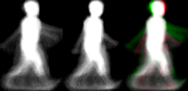
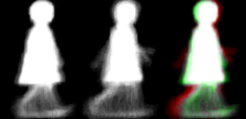
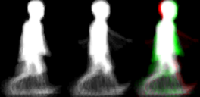
Performance evaluation of gait recognition Effects of age
Equal Error Rate (EER) among genders and age groups
Better performance
Gradual improvement
Dissimilarity distribution of the same subjects
Male
Female
Age
Age
Dissimilarity
Dissimilarity

Slide 24
Conclusion and future work
Conclusion
We constructed the world’s largest gait database
The number of subjects: 4,007
Age range: 1 to 94 yrs
Gait-recognition performance is evaluated with statistically reliability
Comparison of state-of-the-art gait representation
Study on the performance difference between genders and age groups
Future work
Data collection of very young child and elderly

