Slide 1
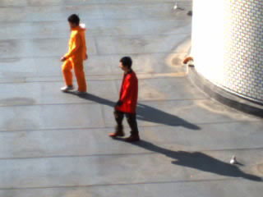

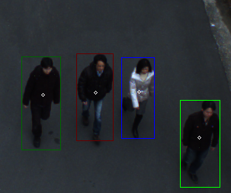
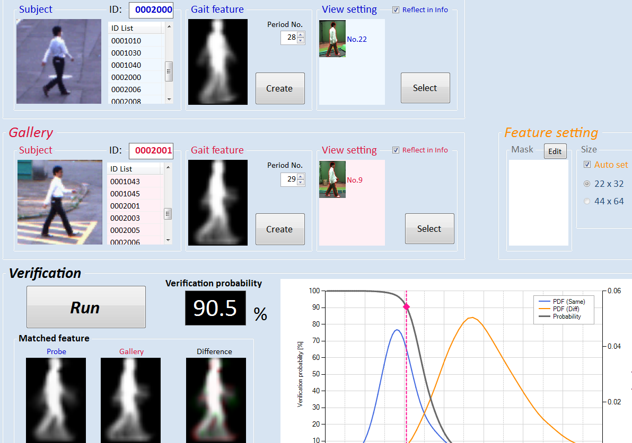
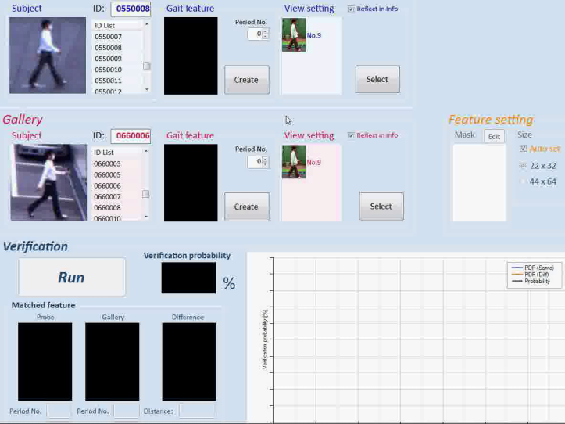
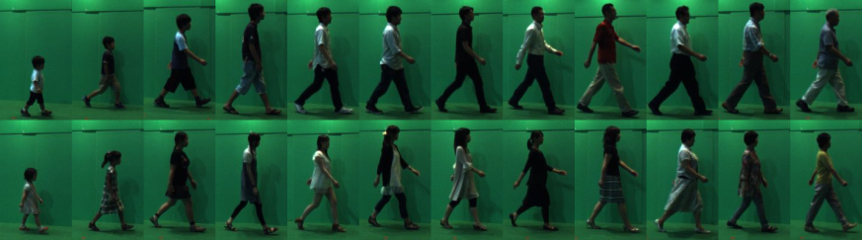
Foreground and shadow segmentation
Context-aware person identification
Homography-correspondence pair-based
labeling with occlusion handling
Identity propagation based on group
affiliation and behavioral relations
Theory
Identity estimation from neighbors
Left side
Right side
Gait-based person authentication
Graphical model
Database
Verification system
Construction of the world’s largest
gait database
Performance evaluation of gait -based
person identification
Construction of forensic tool for
non-gait-specialist (e.g., criminal investigator)
Application
Number of subjects : 4007
Age : 1 to 94 years old

