Slide 1
Full-dimensional Sampling and Analysis of BSSRDF
OS1-2
Chika Inoshita, Seiichi Tagawa, MD. Abdul Mannan
Yasuhiro Mukaigawa, Yasushi Yagi
ISIR, Osaka University

Slide 2
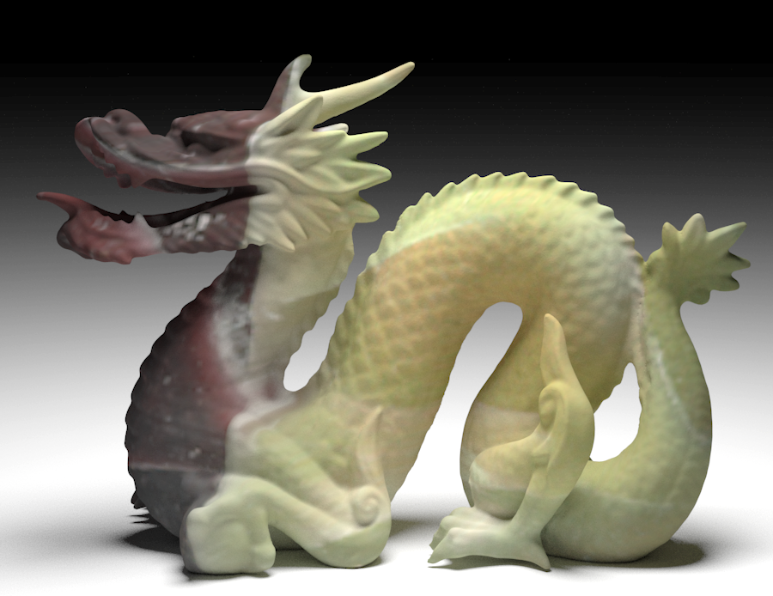
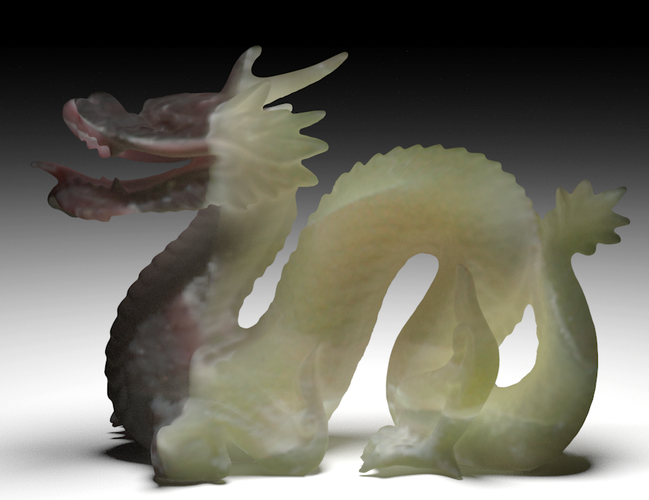

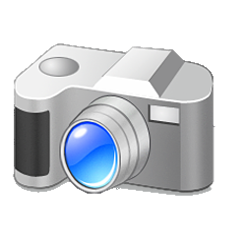
Surface reflectance vs. subsurface scattering
Opaque object
Translucent object
Surface reflection
Subsurface scattering

Slide 3
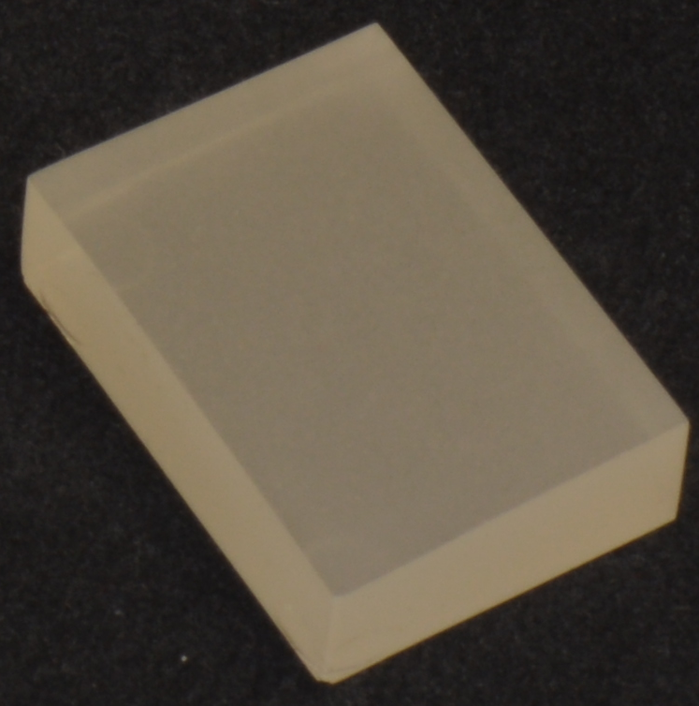
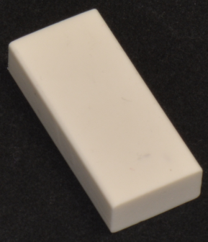
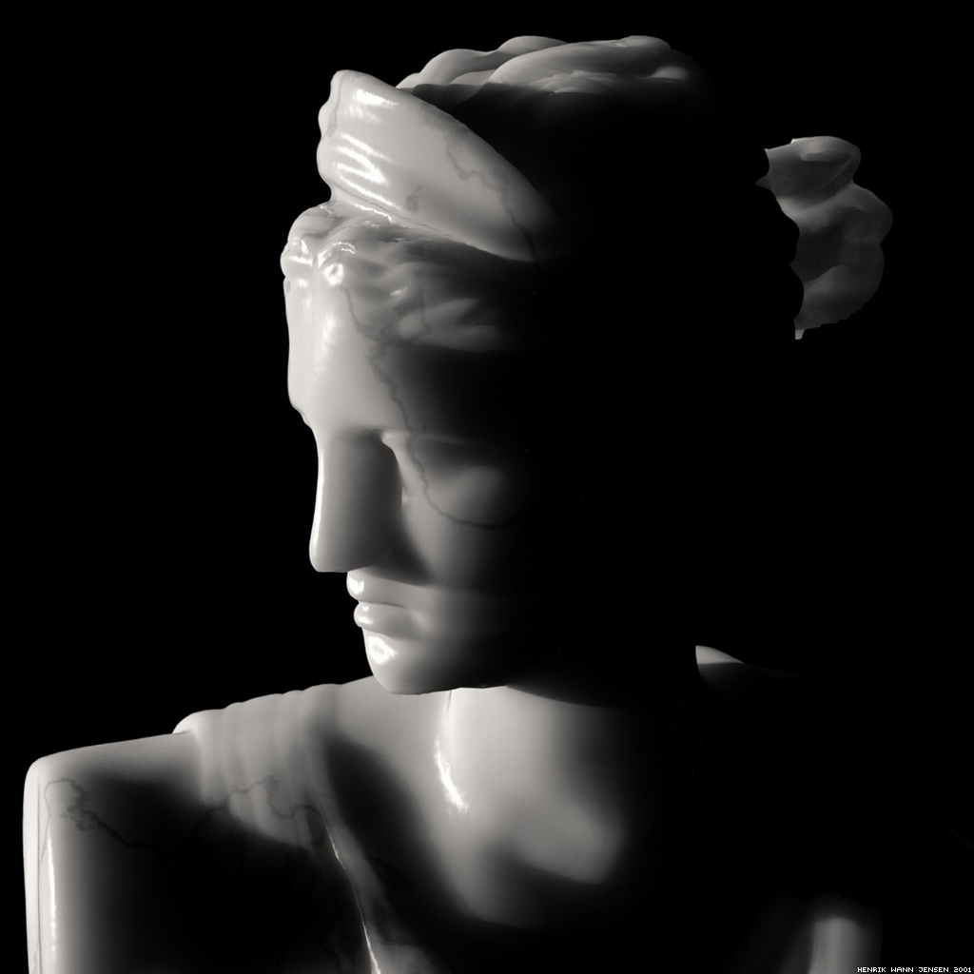
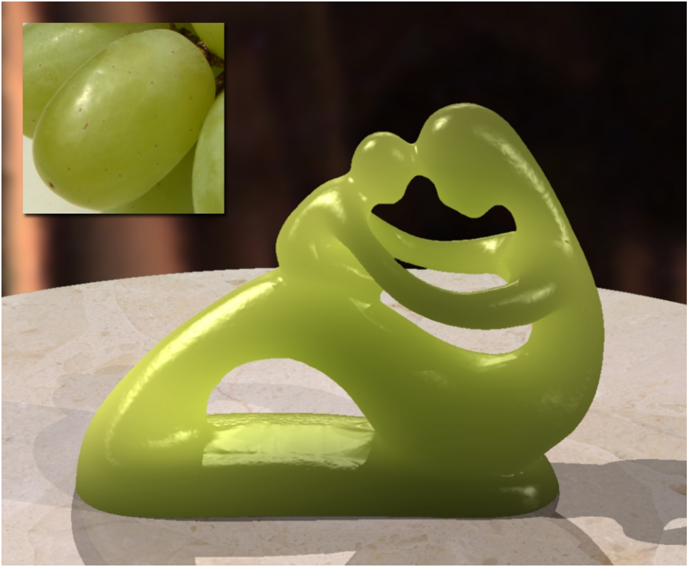
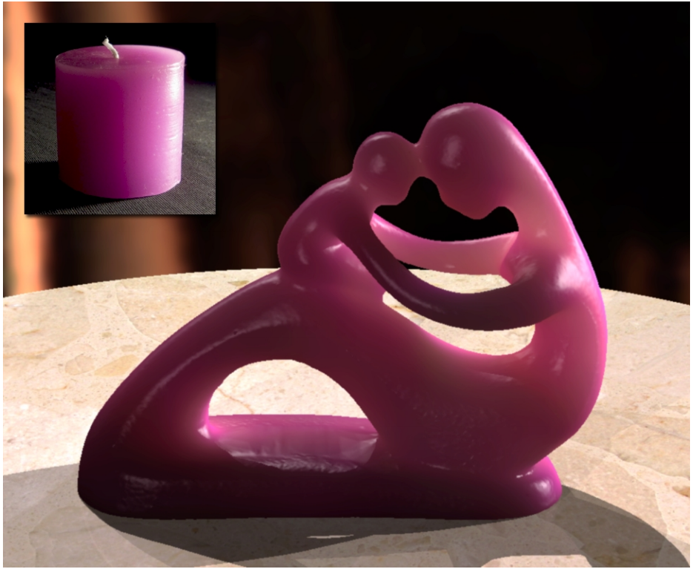
Research on subsurface scattering
In progress
Scattering in homogeneous media by 5D function
I
I
ω_{i}
ω_{o}
ω_{i}
ω_{o}
Scattering does not depend on
incident position
d
d
Dimensionally reduced BSSRDF: f(ω_{i}, ω_{o}, d)
(Bidirectional Scattering Surface Reflection Distribution Function)
Plastic
Sampling
Modeling
Dipole model
[Jensen et al. SIGGRAPH2001]
Quantized-diffusion
[Eugene and Geoffrey SIGGRAPH2011]
PSF for scattering
[Premoze et al. EGSR2004]
[Munoz et al. EG2011]

Slide 4
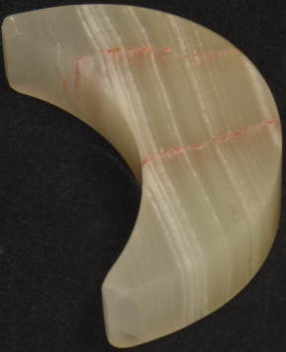
Research on subsurface scattering
Scattering in inhomogeneous media by 8D function
I
I’
ω_{i}
ω_{o}
ω_{i}
ω_{o}
Scattering
depends on
incident position
x_{i}
x_{o}
x'_{i}
x'_{o}
Marble
Full-dimensional(8D) BSSRDF: f(x_{i}, ω_{i}, x_{o}, ω_{o})
(Bidirectional Scattering Surface Reflection Distribution Function)
Sampling
Analysis
Modeling
Not yet
Not yet
Not yet

Slide 5
Objective
Sampling and analysis of
full-dimensional(8D) BSSRDF
Sampling
How to arrange cameras and illumination
Analysis
How to get information from high dimensional data
?
?
Target
8D data

Slide 6
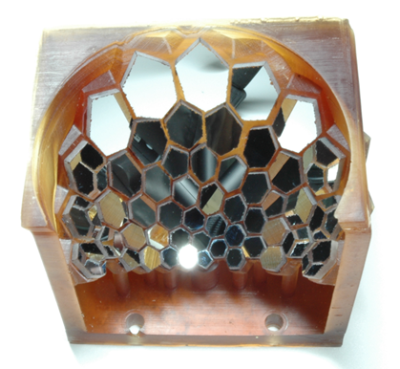
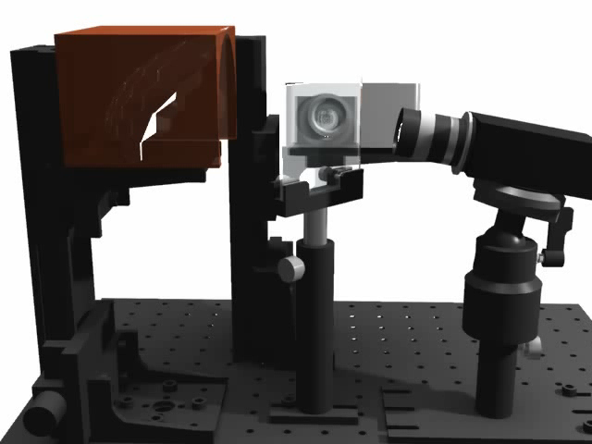
Our solution
Turtleback reflector [Tagawa et al. MIRU2010, Mukaigawa et al. ACCV2010]
Distribute virtual cameras and projectors with polyhedral mirror
Turtleback reflector
System overview

Slide 7
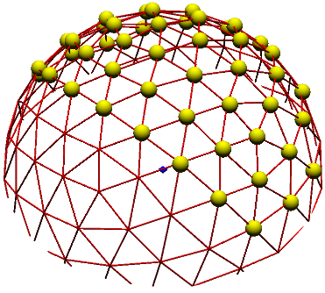
Specs
Direction of projectors ω_{i}=(θ_{i}, φ_{i}): 48
Direction of cameras ω_{o}=(θ_{o}, φ_{o}): 48
Incident positions x_{i}=(x_{i}, y_{i}): 400
Outgoing positions x_{o}=(x_{o}, y_{o}) : 10000
Resolution of BSSRDF f(x_{i}, ω_{i}, x_{o}, ω_{o}):
48 x 48 x 400 x 10000 = 9.216 x 10⁹
Arrangement of virtual
projectors and cameras
Suitable for measuring full-dimensional BSSRDF

Slide 8
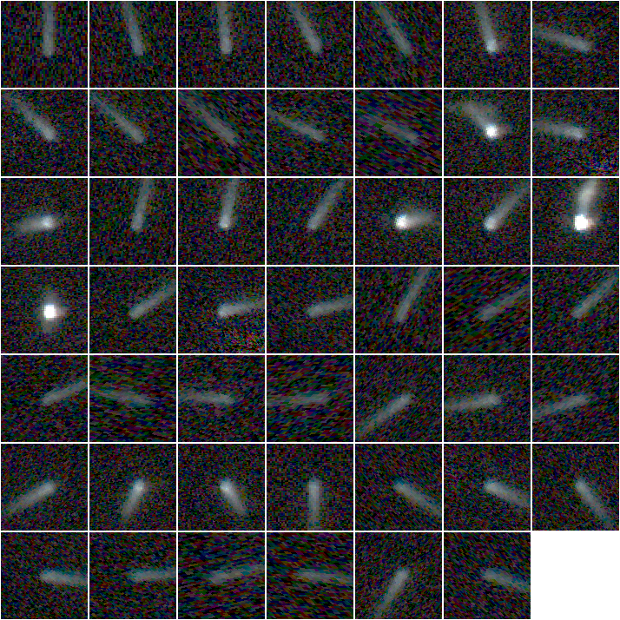
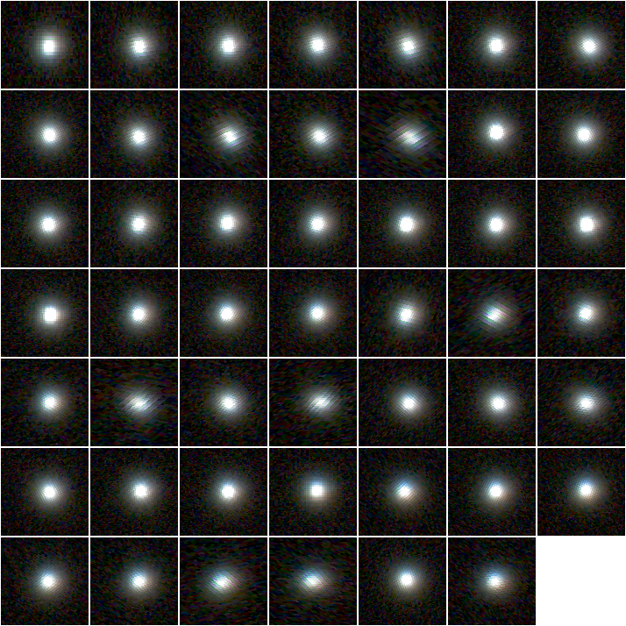
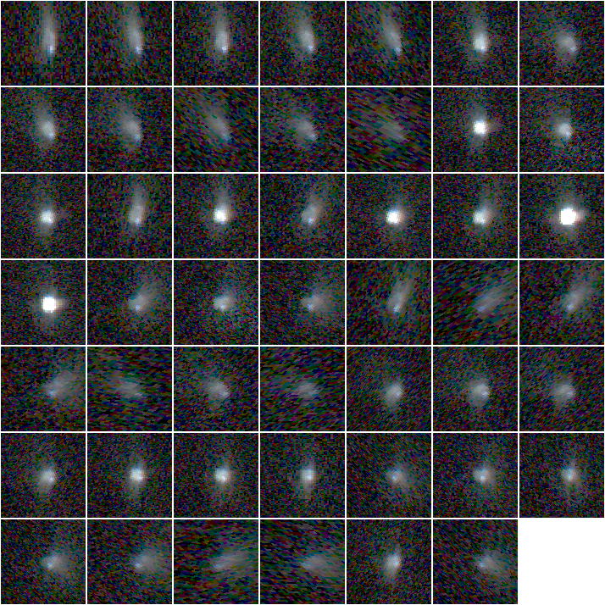
Target materials and examples of captured images
Epoxy resin
Rubber eraser
Marble
Homogeneous
and
optically thin
media
Homogeneous
and
optically dense
media
Inhomogeneous
and
optically thin
media
Captured images with fixed illumination

Slide 9
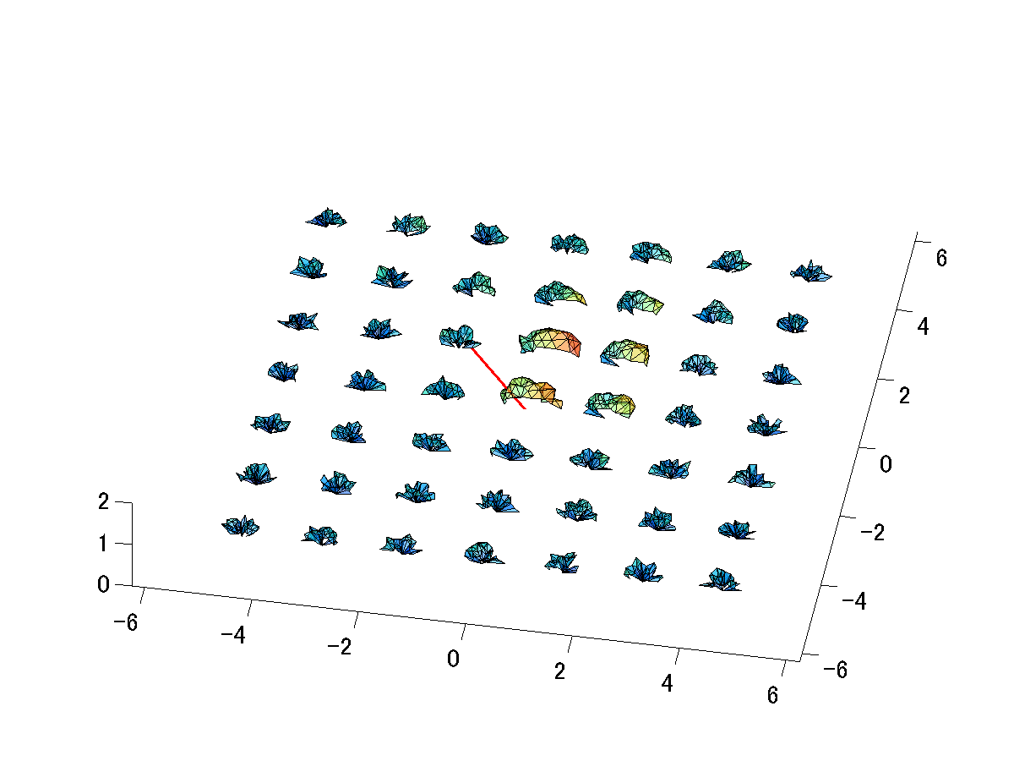
Analysis of sampled BSSRDF
Problem remark
How to analyze high dimensional data??
Our proposal
Analyze 4D slice of BSSRDF f(x_{o}, ω_{o}) by visualization
Decompose BSSRDF based on angular dependency
4D slice
of BSSRDF
=
+
General BSSRDF
Angular dependent
component
Angular independent
component

Slide 10
Visualization of BSSRDF
Analyze by visualizing 4D slices f(x_{o}, ω_{o}) of BSSRDF
Overview of visualization
Plot light distribution
at each outgoing position x_{o}
x_{o}
ω_{o}
x_{i}
Target object
Examinations:
Difference of 4D slices f(x_{o}, ω_{o})
with fixed incident direction
Difference of 4D slices f(x_{o}, ω_{o})
with fixed incident position
Homogeneous
vs.
Inhomogeneous
ω₁
ω₂
Optically thin
vs.
Optically dense
x₁
x₂

Slide 11
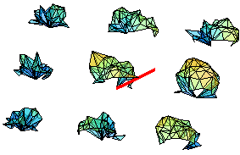
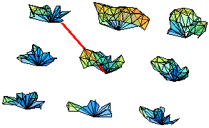
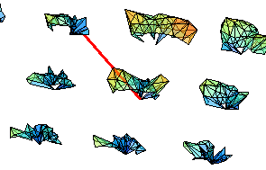
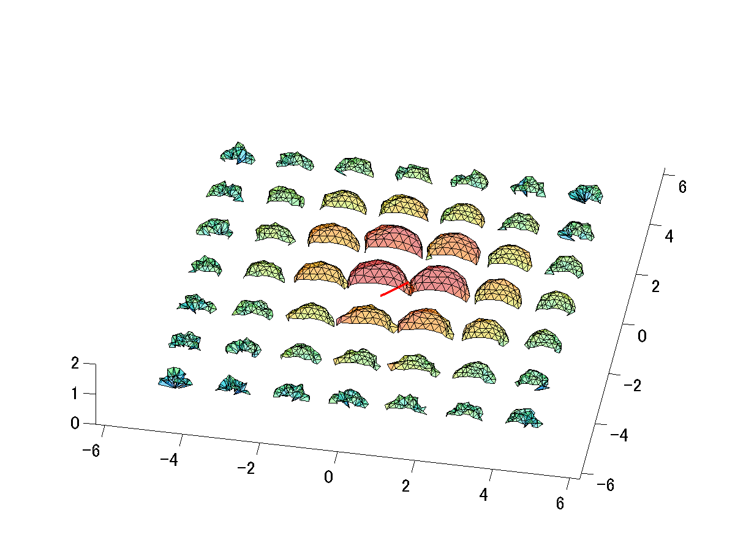
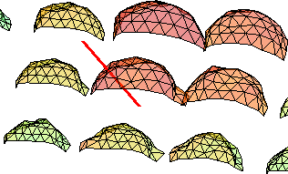
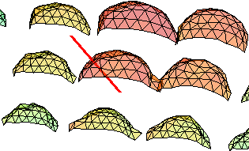
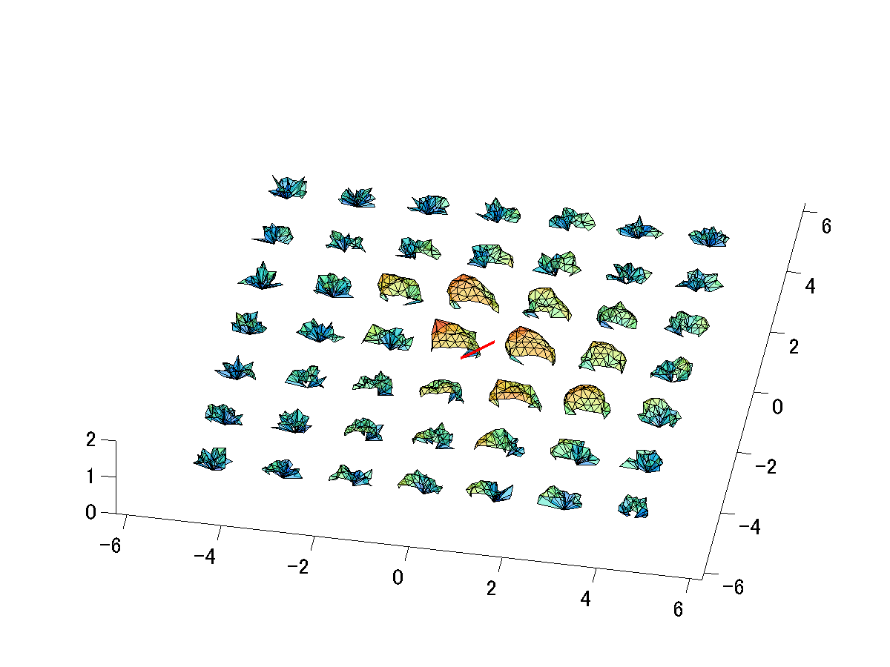
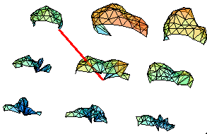
Comparison of 4D slices
あ
Ｚ
Epoxy
resin
Same distribution (Homogeneous)
Different distribution (Optically thin)
Ｚ
Rubber
eraser
Same distribution (Optically dense)
Same distribution (Homogeneous)
Ｚ
Ｚ
Different distribution (Optically thin)
Different distribution (Inhomogeneous)
Marble

Slide 12
BSSRDF analysis based on angular dependency
Principle of actual BSSRDF
Consisted of both angular dependent and independent components
=
+
General BSSRDF
Angular dependent
component
Angular independent
component
Need to decompose these components

Slide 13
Decomposition algorithm
Inspired by specular and diffuse decomposition [Nishino et al. ICCV2001]
BSSRDF
f(x_{i}, ω_{i}, x_{o}, ω_{o})
ω_{o}
Angular dependent component
Angular independent component
ω_{o}
General BSSRDF
Angular independent
component
Angular dependent
component

Slide 14

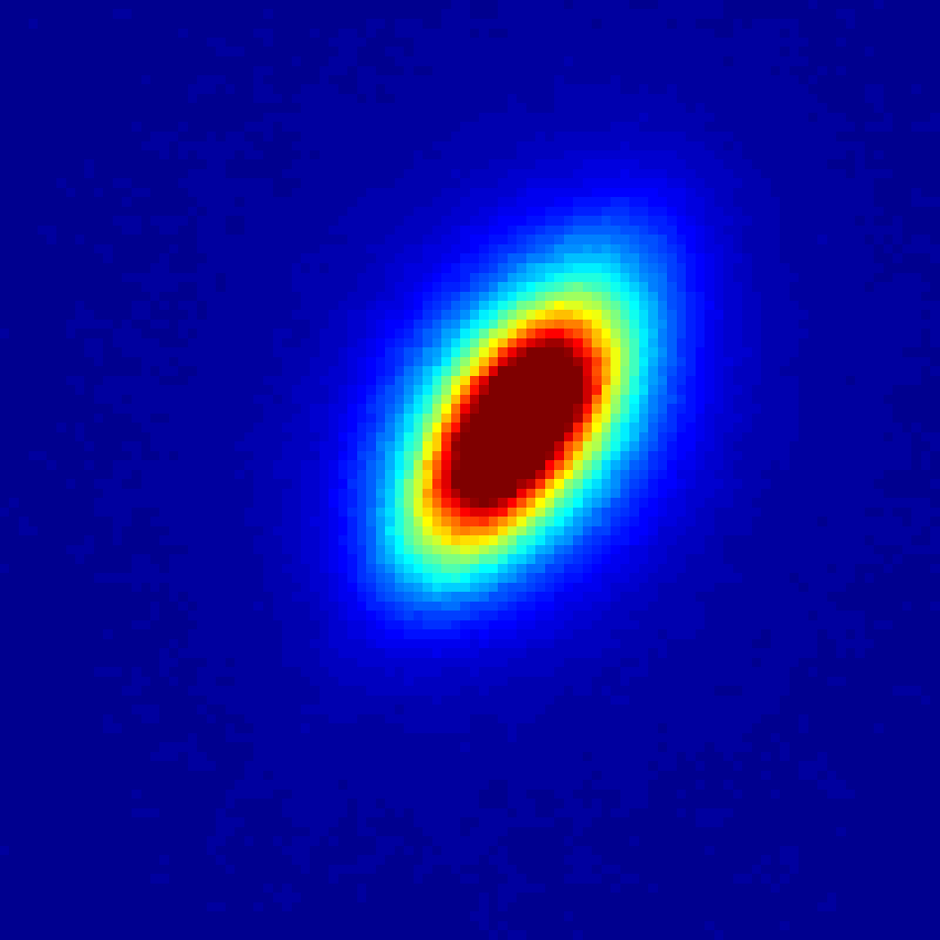
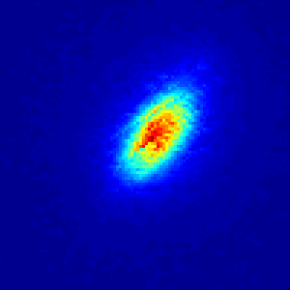
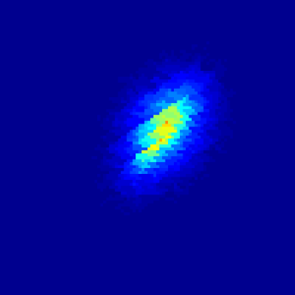
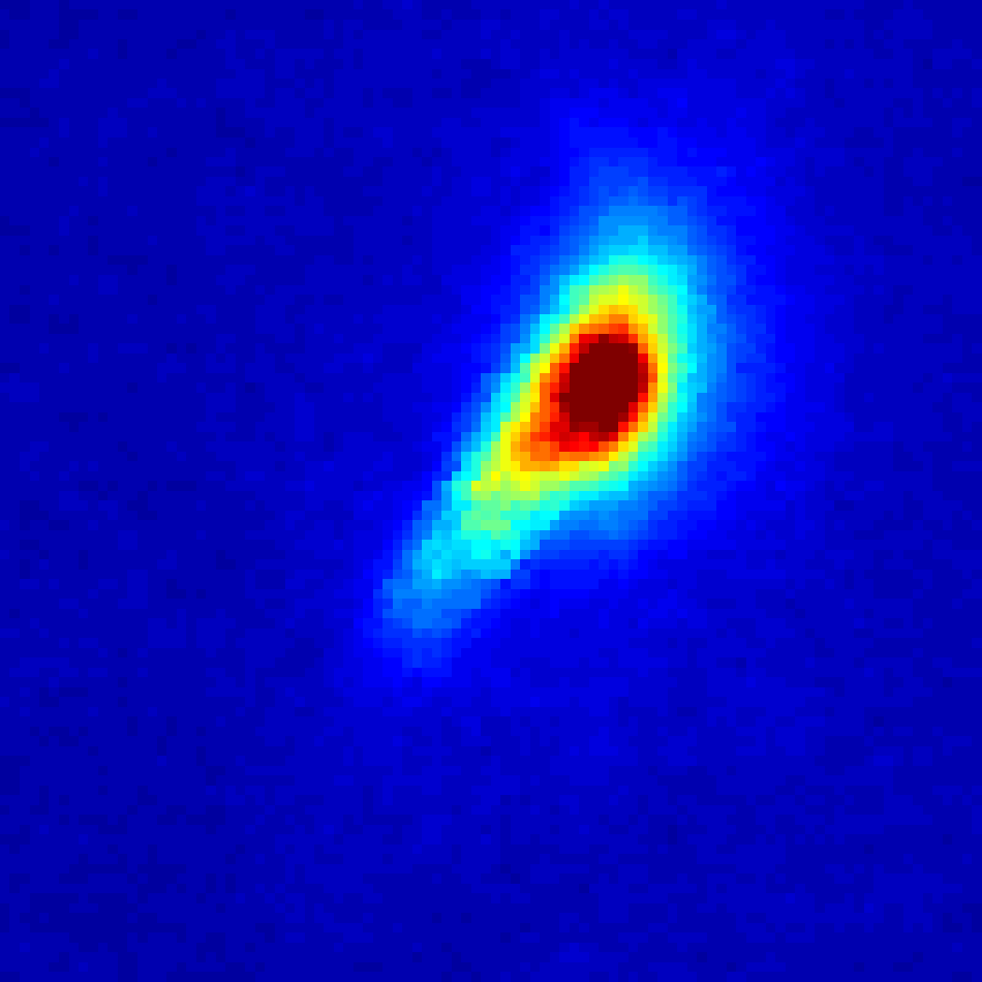
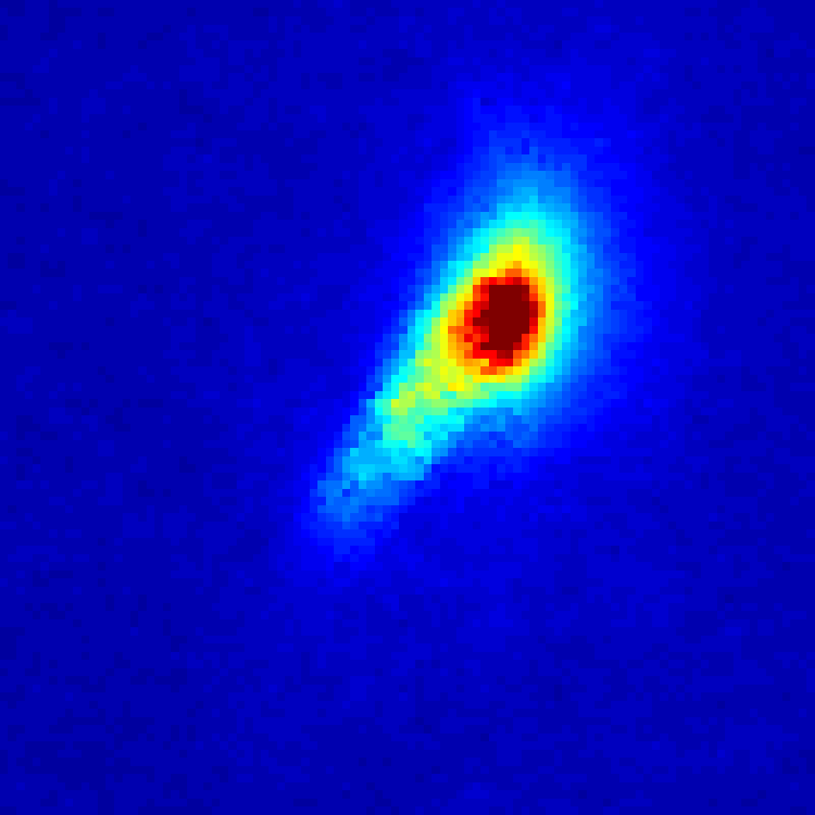

Decomposition result
Both components
Angular dependent
component
Angular independent
component
Dominants in
optically thin material
Epoxy resin
(Optically thin)
Symmetric in homogeneous media
Dominants in
optically dense material
Rubber eraser
(Optically dense)
Asymmetric in inhomogeneous media
Marble
(Inhomogeneous)

Slide 15
Optical characteristics vs. Sampled BSSRDF
Empirical BSSRDF characteristic of each material
High
Change with
incident direction
Constant with
incident direction
Epoxy resin
Dominant angular dependent component
Rubber eraser
Dominant angular independent component
Homogeneity
Change with incident direction and position
BSSRDF shows
various
optical characteristics!
Marble
Dominant angular dependent component
Low
Low
Optical density
High

Slide 16
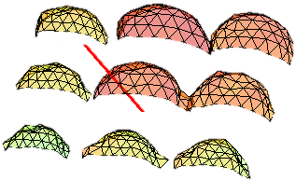
Summary
First trial to sample and analyze full dimensional BSSRDF
Show empirically BSSRDF feature of several materials
BSSRDF decomposition based on angular dependency
Future work
Make BSSRDF database of various materials
Formulate parametric BSSRDF model

Slide 17
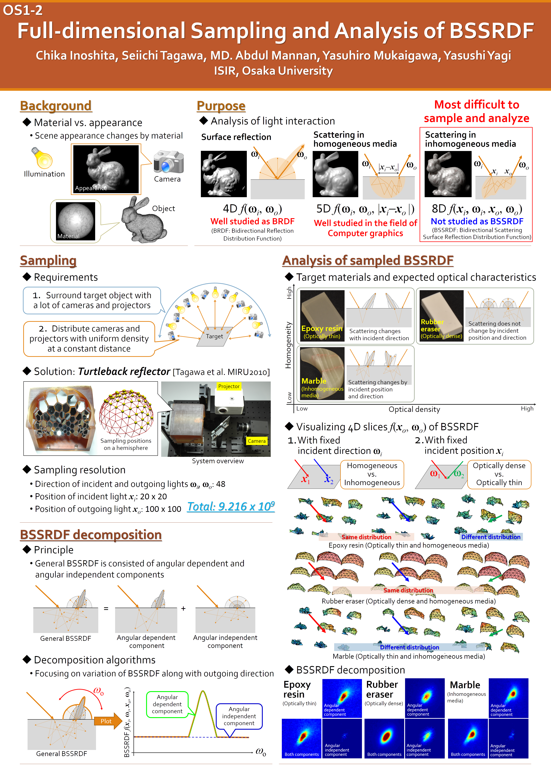
OS1-2 Full-dimensional Sampling and Analysis of BSSRDF
Please come to
our poster!

